Slide 1
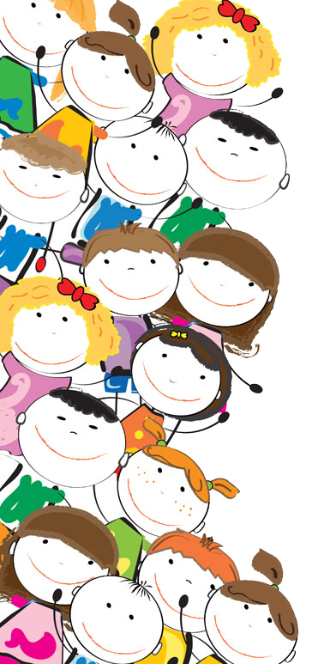
Mrs Fear’s Class 2020 - 2021

Slide 2
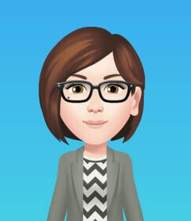
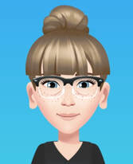
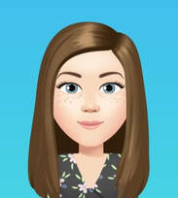
Meet our team.
I am Mrs Fear. I will be your teacher this year. We will have a great year together, getting to know each other, learning and having fun.
We are Mrs Goodison and Miss Tuxford. We are your teaching assistants and are really looking forward to teaching you all this year.

Slide 3
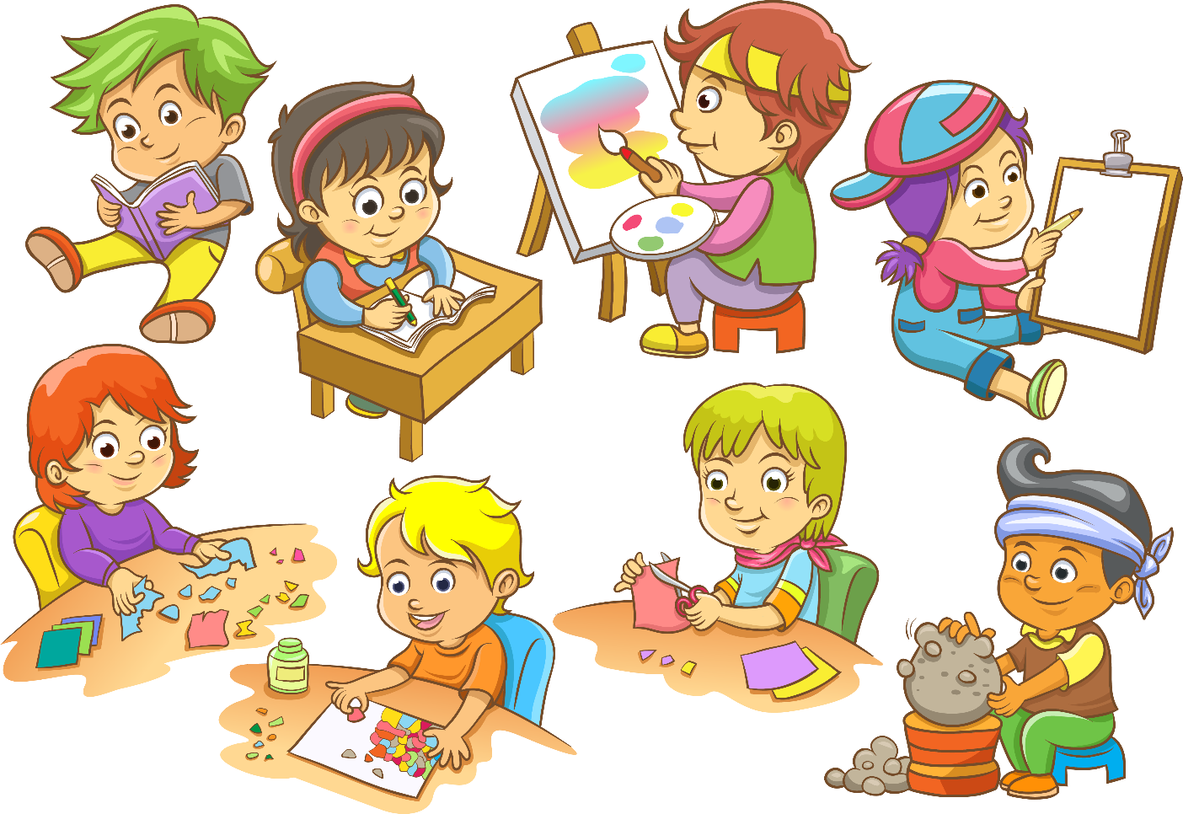
Hello everyone, I am so pleased that you will be joining our class in September. I love art and being creative so hopefully you will show me how creative you can be with your ideas, drawings, paintings and words. I like to sing, dance and be active so we will be including activities like this during our day.

Slide 4
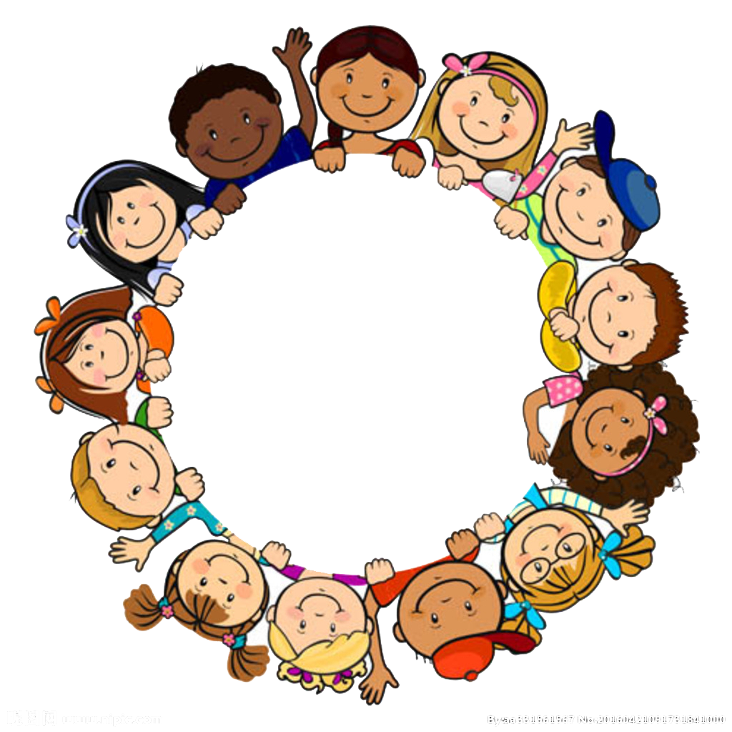
I think that to be kind is the most important thing you can be so that is what I want from everyone in our class. We will use kind words to talk to each other and try to be helpful to every body. If you are feeling unsettled or worried about something, Mrs Goodison, Miss Tuxford or myself will always be there to listen and help you. We are a team and we work together to solve any problem – however big or small.
Kindness

Slide 5
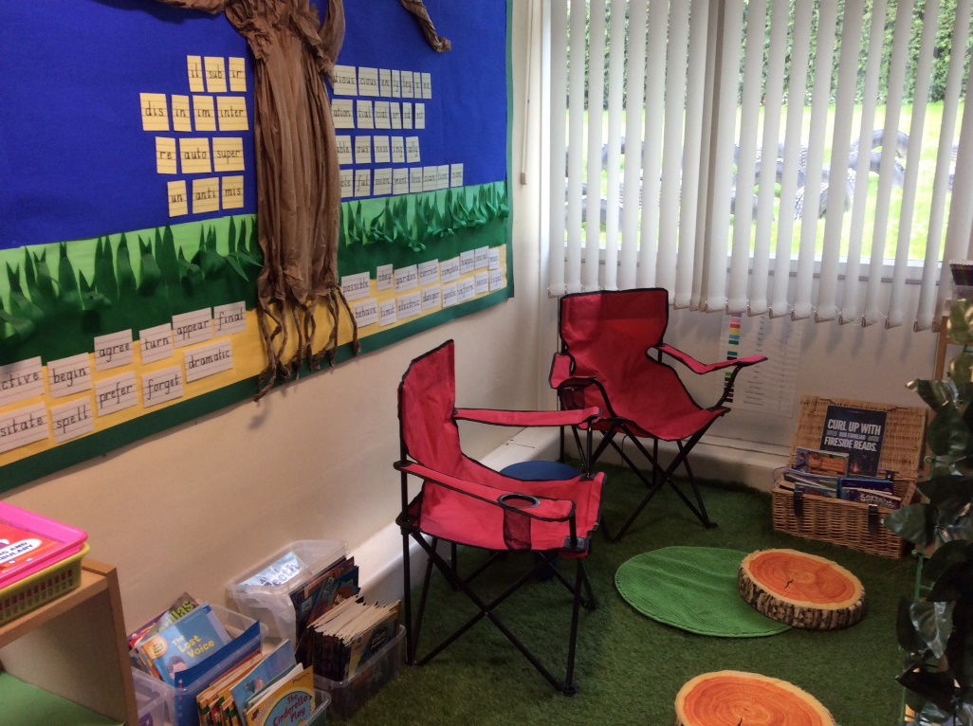
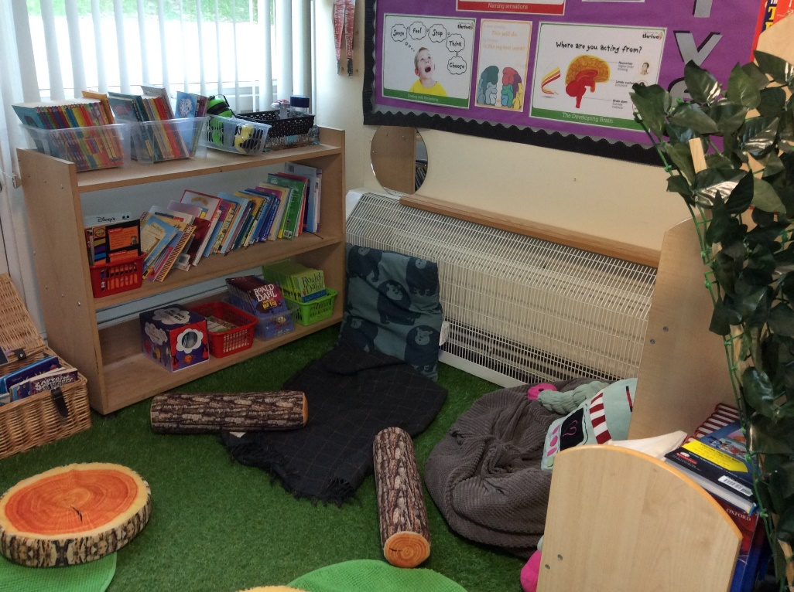
I love books and the magical places that they can take you to. We will read a story to you at the end of every day and will use stories in our lessons to help give us ideas. We will look at a mixture of types of books – longer chapter books, picture books, books with no words, and non-fiction books. You can also look forward to taking part in reading and book days as a whole school.

Slide 6
We love PE! Mr Gale or Mrs Fear will teach you different games and skills in PE. You will do team games, athletics, dance, gymnastics and lots more. We don’t know about swimming lessons at the moment so there will be more information about these is September.
We love Maths and English.
We will teach you lots of new maths and English skills. We will work hard to find out what you know already and, from there, we will take you on the next steps in your learning. We will challenge your thinking but will make sure you have the time, models and equipment you need to explore the idea further and help you remember what you learn. I love to learn new words through talking to others and reading. We will be trying to include words that we learn into our writing and learn to write in lots of different styles.
We love to learn.
We will be learning about Anglo-Saxons, Vikings and the Mayans, as well as map skills, sculpture, painting, coasts, sewing… so many things! We willl also be starting to learn Spanish.

Slide 7
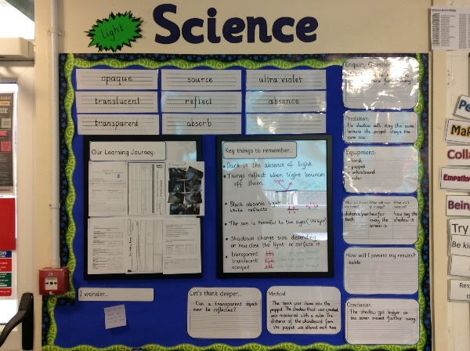
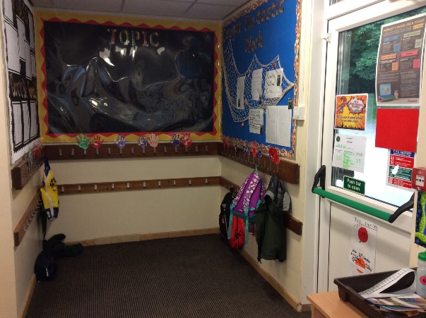
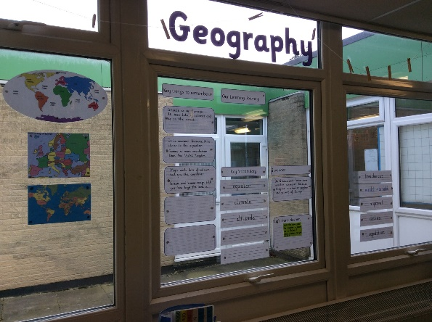
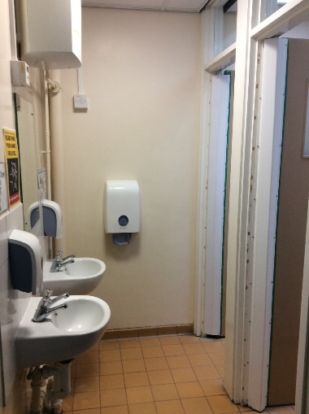
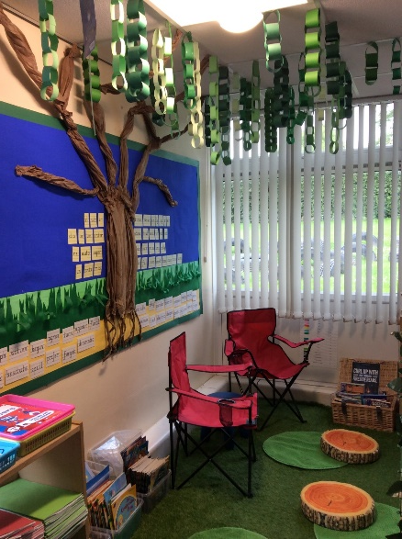
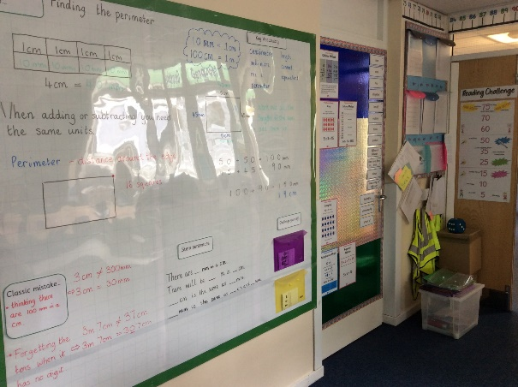
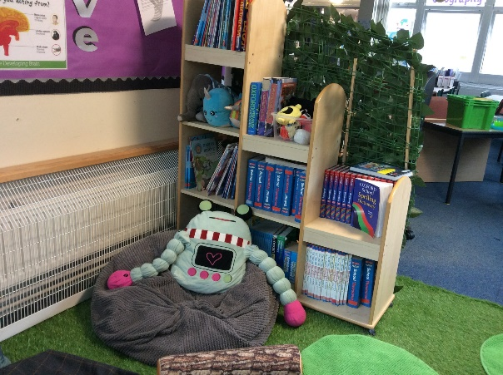
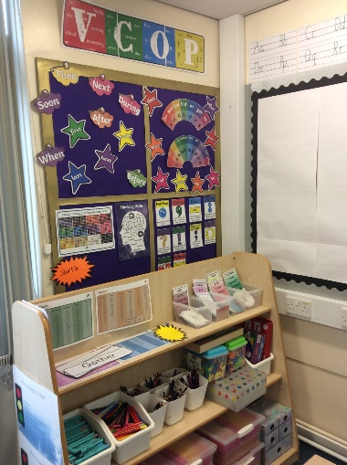
Our Classroom.
In our classroom we have an area for investigating, exploring and practicing our skills. The rest of our room is set up for whole class learning where displays and resources will help us with our ideas and have reminders of our previous learning. We have a grassy reading area for enjoying books. .
We have our own cloakroom and even our own toilets.

Slide 8
Our School Day When you arrive at school your grown up will say goodbye at the door where we will be waiting for you. Then you will take off your coat and hang it on your peg, along with your bag. You will then sit at your desk and complete your morning work. We will do the register and say hello to everyone. We like to start the day with a little dance or exercise before starting reading. At playtime, you can pay to have toast/snack. When you come in from playtime, it will be time for our maths and writing learning. Then you will have lunch and playtime. After lunch, we will get busy again in our classroom, practicing our skills and learning about our topics. At the end of the day, we will have another story and get ready for home after our busy day.

Slide 9
See you all in September.

