Slide 1
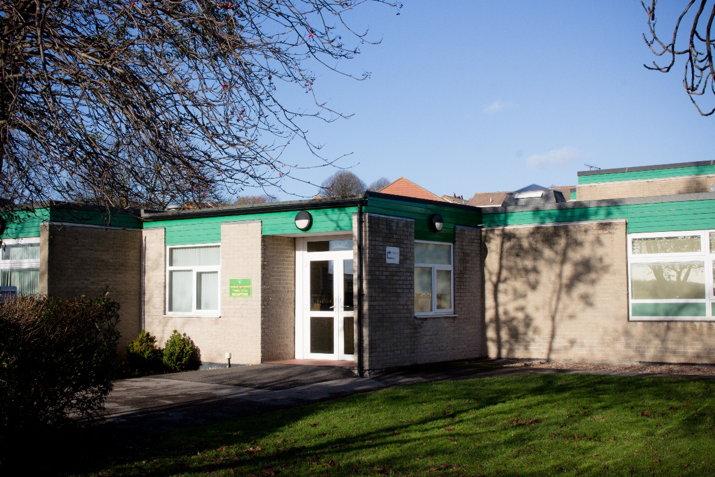
Welcome to New Parents
Hoyland Springwood Primary School

Slide 2
EVERY CHILD MATTER ACADEMY TRUST
At the ECMAT our vision is to build a collaboration of schools where openness, honesty, fairness and empathy, together with the development of best practice, ensure all children within our schools receive a first class education. Through system leadership we will support the practice of other schools and academies beyond our Trust to enable them to achieve the same outcomes. Children are at the heart of all we do. We will provide EVERY CHILD with early help and support to remove barriers to learning and an education that raises aspiration resulting in excellence and enjoyment. This will enable all children to fulfil their potential and maximise their life chances. As a Multi Academy Trust our core principles are to:
strive for excellence in all that we do;
have a clear focus on school improvement;
work with families to improve life chances;
make a commitment to life-long learning; and
ensure each school maintains its own identity whilst collaborating as one organisation.
ECMAT formed in October 2015 with founder members being High View Primary Learning Centre, Hoyland Springwood Primary School and Wombwell Park Street Primary School.

Slide 3
Vision and Ethos
Our school is a vibrant and happy place where the children are at the heart of every decision we make to ensure that they believe in themselves and are confident learners. The school has a dedicated team that works hard to reach high standards in everything we do and this is further embedded through our successful relationships with the children themselves, the parents, the local community and the other schools in the ECM Trust. The school's ethos is that: TOGETHER WE SHINE Succeed … Happy … Individual … Nurturing … Excel We firmly believe that education is a partnership between home and school and regard you as an active partner in your child's education and value your interest and support. We have a learning community that we are thoroughly proud of and visitors often comment on how warm and welcoming the school feels.

Slide 4
OFSTED
OFSTED in September 2018 and GOOD in all areas
“ Senior leaders set high expectations for pupils and staff. They model positive relationships and are highly respected by parents and carers, who value the strong sense of community and belonging which the school provides.”
“Leaders ensure that the care and welfare of pupils are paramount. This results in a nurturing and inclusive school community.”
“Pupils behave well, feel safe and are valued as individuals. Pupils, staff and parents recognise improvements in pupils behaviour.”
“ Leaders have built a strong sense of community within the school. Positive relationships between pupils and staff make sure that pupils feel supported and valued so they can develop as confident and self-assured learners. Consequently, pupils have good attitudes to their learning and take pride in working hard and cooperating with others.”
“The curriculum helps pupils learn how to stay safe and be healthy. At lunchtime, there is a range of activities which support their physical and social development. Through themed weeks and assemblies, pupils gain a secure understanding of how to be safe.”
“Pupils say that bullying is rare and that they are confident that adults in school would be there to listen should they have any concerns. A culture of respect for others permeates the school and helps to prepare pupils well for life in modern Britain.”

Slide 5
Curriculum
Basic Skills are taught throughout the curriculum and are a focus in what we teach.
Early Reading is taught using Read Write Inc (RWI). More information will be shared about this scheme in September and there is more info on our website.
LEAP is the basis for our full school curriculum and it drives what we plan each day. Every day, we aim to:
develop our children's LANGUAGE
give them amazing EXPERIENCES
let they ASPIRE to be anything they choose
give chances to PERFORM in all areas
The Early Years Foundation Stage (EYFS) continues until the end of the reception year focusing on the three prime areas of learning: personal, social and emotional development; communication and language; and physical development. Along with four specific areas of learning: literacy; mathematics; expressive arts and design; and understanding the world.
We use our extensive school grounds. The class will learn outside as much as possible and have wider opportunities outside the classroom and beyond the school.

Slide 6
Pupil Premium (additional funding)
All pupils in Reception, Yr1 and Yr2, are entitled to a free school meal under the ‘Universal Free School Meals’ scheme.
Some pupils will also be entitled to an additional grant of up to £1,320 by claiming for ‘Free School Meals’. This money is used by the school to provide additional educational provision – the office can help you to apply for this or find out more via this website... https://www.barnsley.gov.uk/services/children-families-and-education/schools-and-learning/free-school-meals/
Applications are treated confidentially and your child will not be aware of this designation.
Please let the school know if your child has been adopted, as this will also trigger an additional payment.
Even if you are not sure if your family is eligible for free school meals, please take the time to apply due to the extra funding school receive to support your child. Being eligible also means there is a reduction in price for trips and for the Y6 residential.

Slide 7
School Uniform
Grey or black skirt/pinafore dress or trousers White or bottle green polo shirt or blouse Bottle green sweatshirt, jumper or cardigan Green and white checked dress Black shoes (no trainers) For PE All children should have black/navy shorts and a plain t-shirt available for PE at all times. The t-shirt colour will be red, blue or white depending on their house team. Black/navy tracksuit bottoms and a tracksuit top/sweatshirt may be worn for outdoor PE when the weather is cold and should be available during the colder months.
Black plimsolls can be worn for indoor PE or bare feet; training shoes are required for outdoor activities.
Order forms are available from the school office and is in the welcome pack.
School have a partnership with Vortex school wear which is a local company based in Barnsley. If you wish to order your uniform direct, please follow the link: ​ www.vortexschoolwear.co.uk/Primary-Schools/Hoyland-Springwood-Primary-School

Slide 8
Free Milk and Fruit
All pupils in Reception, Yr1 and Yr2, are entitled to a free piece of daily fruit under the Governments Fruit and Veg scheme.
Pupils are entitled to free milk until their 5th birthday. For your child to receive this you will need to register on online at www.schoolmilkukco.uk

Slide 9
School Payments
The school uses an, online payment system called ‘Parent Pay’.
This is the system you will use to select the menu for school meals and pay for items such as trips.
Look out for further information about this system from the office team, in September 2020.

Slide 10
And finally ….. Any questions?
We understand that you may have many questions about transition into school and what September will look like. We will inform you as soon as we have more information. However in the meantime please do not hesitate to contact us via email
springwood@ecmtrust.co.uk
if you have any questions or queries.
Many thanks from us all and we can’t wait to see you in September
HSW team.

